Slide 1
PROJECT OVERVIEW
1.1 Project Name : EPIC JOURNEY
1.2 Organization Name: Tours and Travels
1.3 Team Members :
13153 - Karan Barge
13156 - Pranav Chaudhari
13158 - Atharv Jagtap
13175 - Govindraj Deosarkar

Slide 2
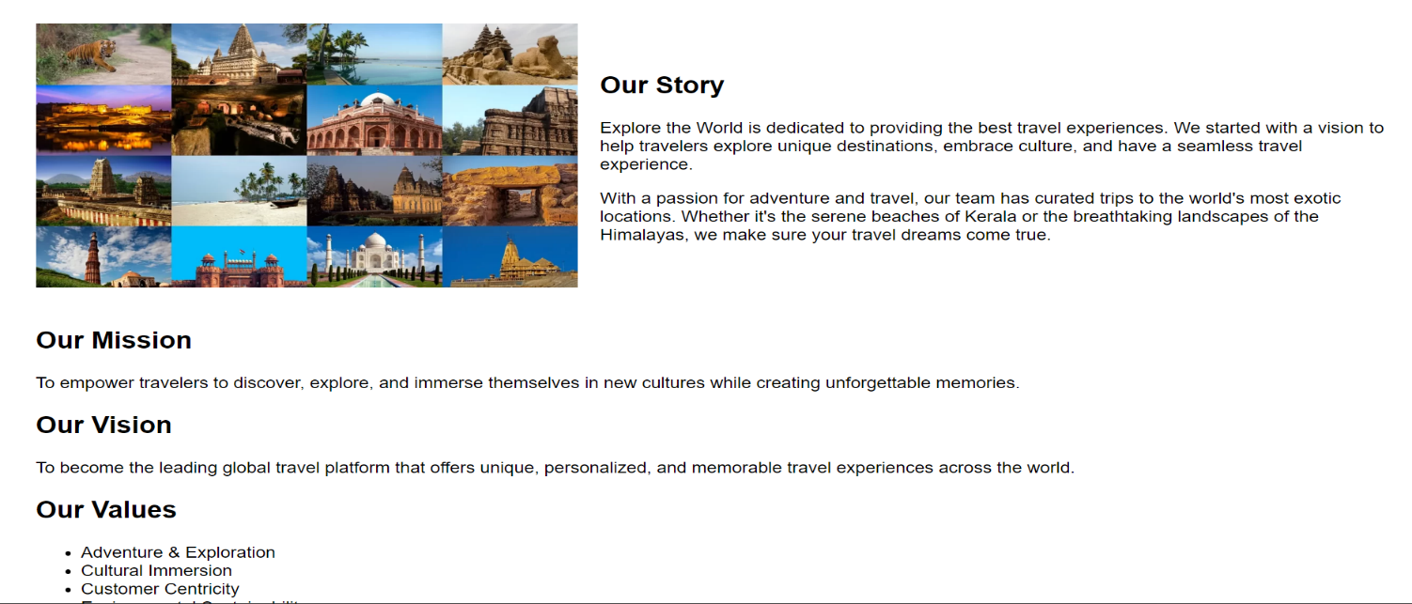
Introduction
Discover the world like never before with Epic Journeys, your ultimate guide to unforgettable travel experiences. Whether you’re seeking breathtaking landscapes, vibrant cultures, or thrilling adventures, our curated content and expert insights will inspire your wanderlust. Join us as we explore hidden gems, iconic landmarks, and the stories that make each destination unique. Let your journey begin here, where every trip is an epic tale waiting to be told.

Slide 3
What We Offer:
Curated Travel Guides: Explore detailed itineraries and local insights for top destinations around the globe.
Personalized Trip Planning: Get tailored travel plans that suit your preferences and budget, ensuring every journey is unique.
Inspiration & Tips: Access expert advice, travel tips, and inspirational stories to ignite your wanderlust.
Exclusive Deals: Enjoy special offers and discounts on accommodations, tours, and activities to maximize your travel budget.
Community & Resources: Join a vibrant community of travelers, share experiences, and find helpful resources to enhance your adventures.
At Epic Journeys, we believe every trip should be extraordinary. Start your adventure today and explore the world with us!

Slide 4
Objectives :
1. User-Friendly Travel Planning
Provide an easy-to-navigate platform that allows users to book travel services such as flights, hotels, and tour packages with minimal effort.
2. Comprehensive Travel Information
Offer detailed information on various destinations, including must-visit places, travel tips, and local attractions to help users make informed decisions.
3. Seamless Booking Process
Streamline the booking process for flights, hotels, and tours, ensuring a smooth, secure, and fast experience from start to finish.

Slide 5
4. Customer Reviews and Ratings
Allow users to access and provide reviews and ratings for destinations, accommodations, and tour services to enhance trust and transparency.
5. Secure Payment Options
Offer multiple secure payment methods, including credit/debit cards and digital wallets, to provide users with flexibility and confidence during transactions.
6. Customer Support and Assistance
Offer 24/7 customer support through email section to help users resolve issues and answer their queries efficiently

Slide 6
Project Methodology Requirements
4.1 Questionnaire Structure / Survey Questions
1. What would be the most important feature you want on the EpicJourney website?
Answer: Easy booking options for travel and simple to access would be my top priority.
2. How do you prefer the website’s homepage to be designed?
Answer: I would like a clean and minimalist design with prominent booking sections.
3. How important is mobile responsiveness for you?
Answer: It’s very important! I often plan trips on my phone, so the site needs to work well on mobile.
4. What kind of service do you need for planning your journeys?
Answer: I need best destination, budget range, types of travel (adventure, leisure), and reviews.
5. How would you like the booking process to be handled on the site?
Answer: I prefer a streamlined, one-click booking process that shows all necessary information like price, and services provided by company before finalizing.

Slide 7
6. How important is it for the website to provide customer reviews?
Answer: Extremely important. I always read reviews before booking, so I’d like them to be easily accessible and trustworthy.
7. Would you like the ability to save multiple itineraries?
Answer: Yes, it would be useful to book trip before making a decision.
8. How would you prefer the payment options on the website to be handled?
Answer: I’d like payment options, including credit cards, digital wallets
9. Do you think integrating social media logins (like Facebook, Google) would enhance your user experience?
Answer: Yes, I’d appreciate it. It makes signing in faster and easier, plus it allows me to share my trips with friends directly.
10. Do you think a services section on trip and destination would be useful?
Answer: yes, it is very important to know our customer that what kind of services we provide due to their journey.

Slide 8
4.2 Data Collection
Ease of Use:
"I’m really impressed with how user-friendly the website is. Navigating through different sections, like finding destinations and booking options, was seamless and intuitive."
Design and Layout:
"The design is clean and modern, which I love. The use of images really brings the travel destinations to life, and the layout feels fresh and organized."
Personalized Features:
"I particularly appreciate the personalized travel recommendations. It felt like the website understood my preferences and suggested exactly what I was looking for."
Overall Impression:
"Overall, I’m really happy with the website. It’s not just functional but also engaging. If I had to suggest one thing, it might be to include more interactive elements like destination videos, but otherwise, it’s fantastic!"

Slide 9
Methodology
5.1 Fact-Finding Techniques
Surveys and Questionnaires:
Conduct online surveys or questionnaires targeting potential users to gather feedback on what features they expect from a travel website. Questions could include preferences for booking, favorite destinations, and desired travel services.
Interviews with Travelers:
One-on-one or group interviews with frequent travelers can provide deep insights into user needs, travel behaviors, and pain points. This method allows for open-ended questions to understand user expectations for features like personalized recommendations or easy booking.

Slide 10
Competitor Analysis:
Analyzing existing travel websites, such as their structure, features, and user feedback, will help identify best practices, gaps in services, and unique opportunities to differentiate Epic Journey from competitors.
Website Analytics:
Use tools like Google Analytics or heat mapping tools on a prototype of the website to track user behavior and interaction patterns. This helps in identifying popular sections, drop-off points, and areas where users spend the most time, guiding further improvements.

Slide 11
5.2 Tools Used
HTML, CSS, and JavaScript: Core technologies for building the structure, styling, and interactivity of the website.
Bootstrap: A CSS framework that helps create a responsive and mobile-friendly design quickly.
Google Analytics for tracking user behavior

Slide 12
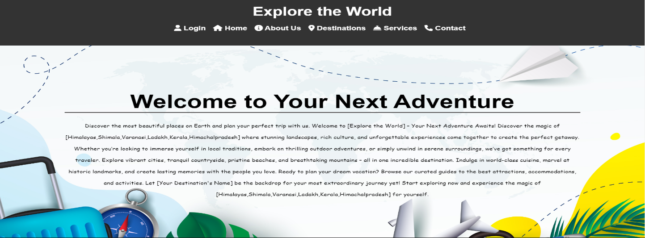
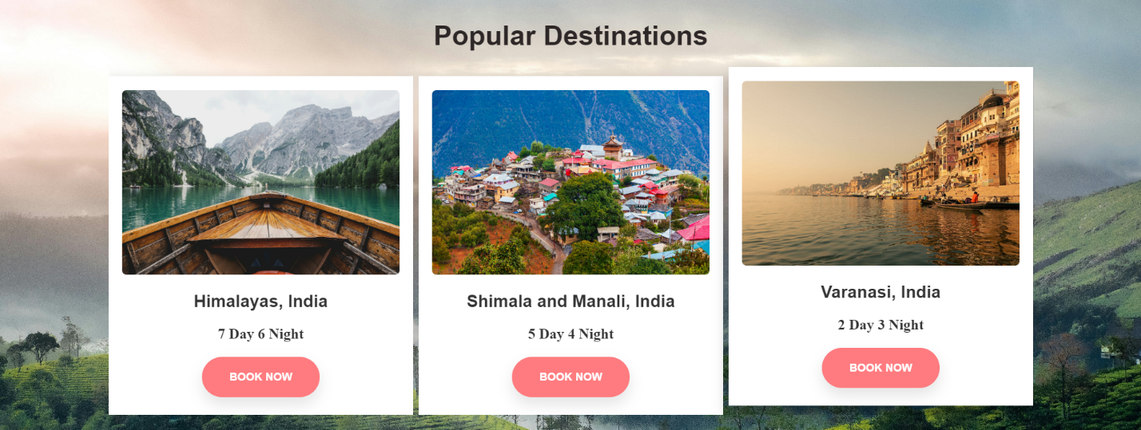
Project Analysis

Slide 13
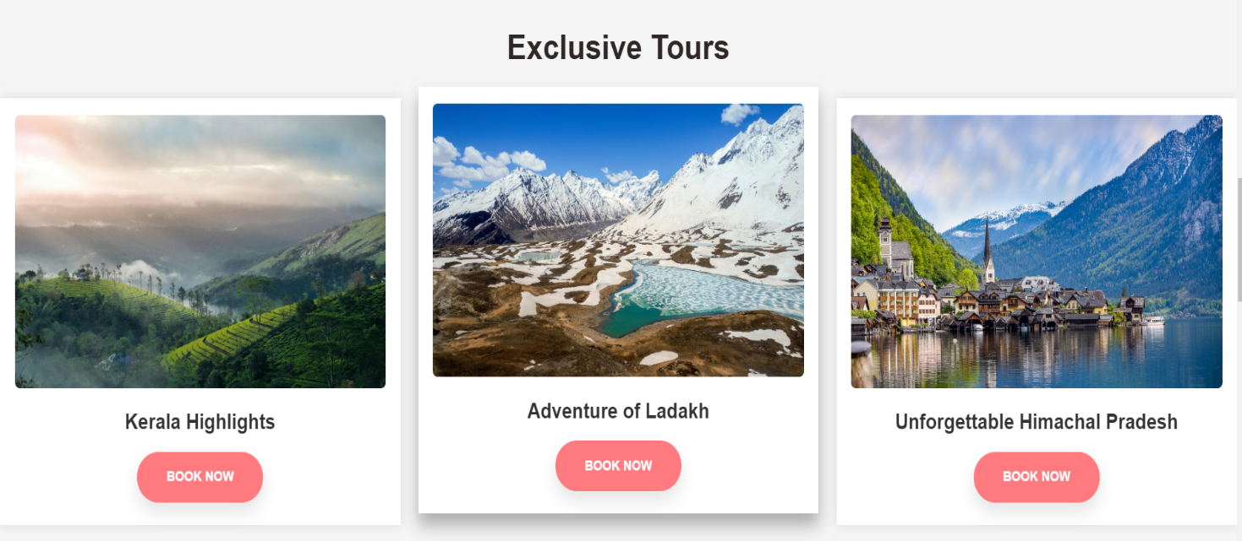

Slide 14
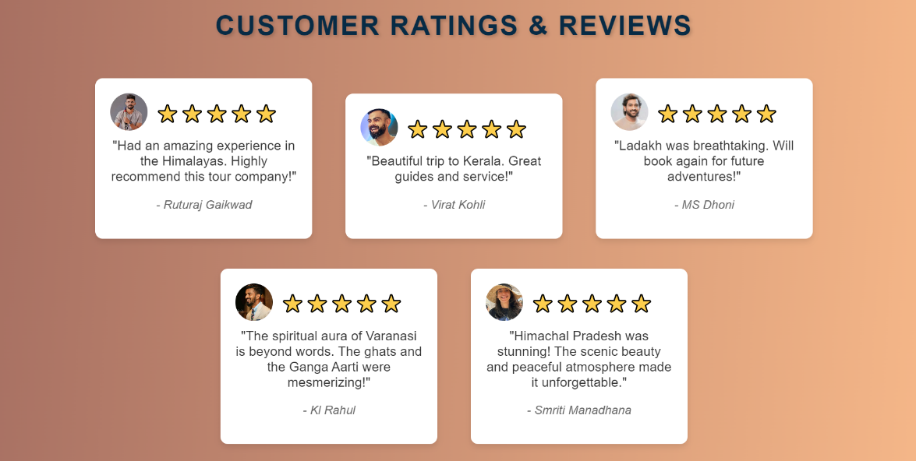
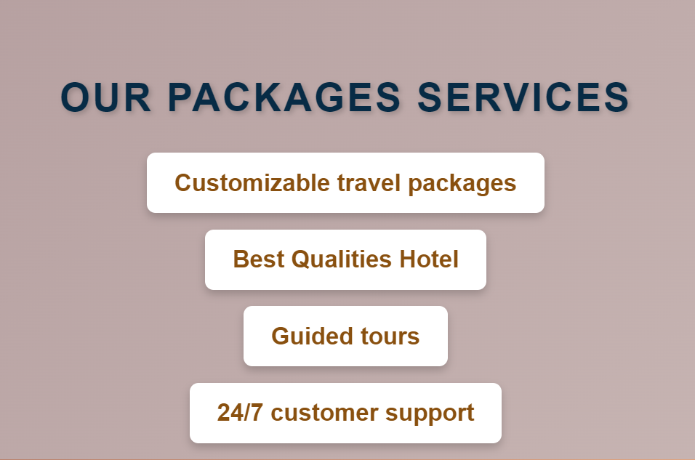

Slide 15
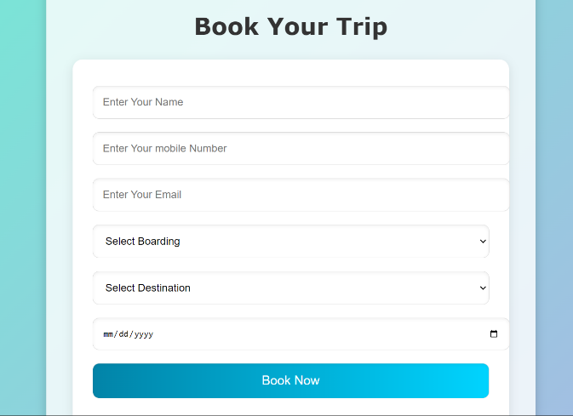
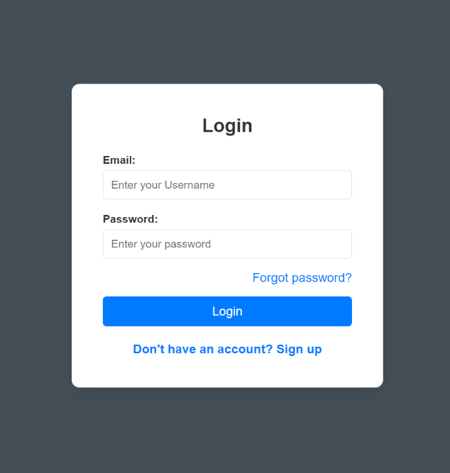
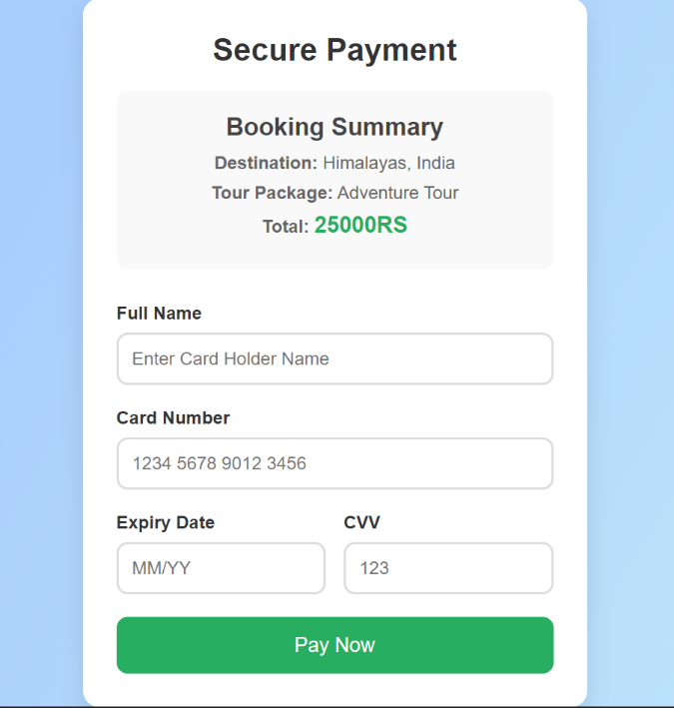
FOR LOGIN
FOR BOOKING TRIP

Slide 16
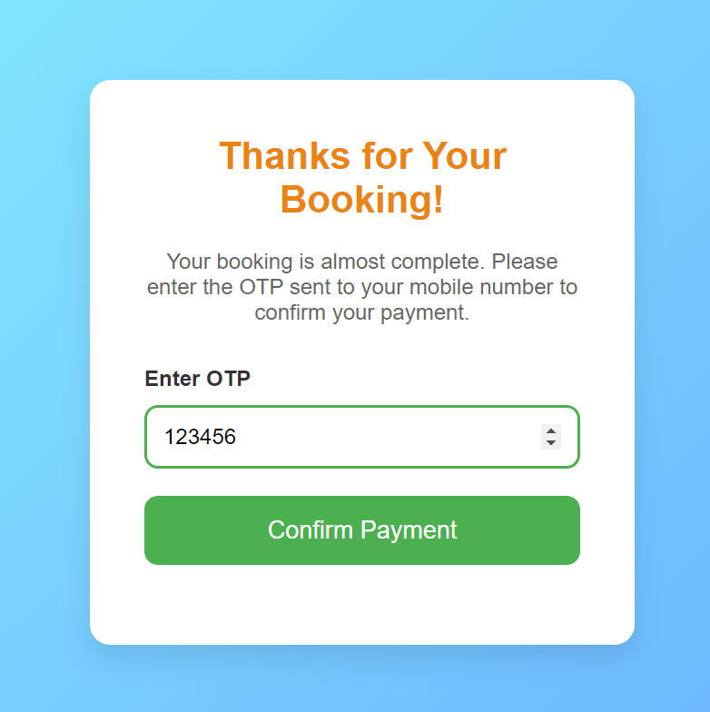
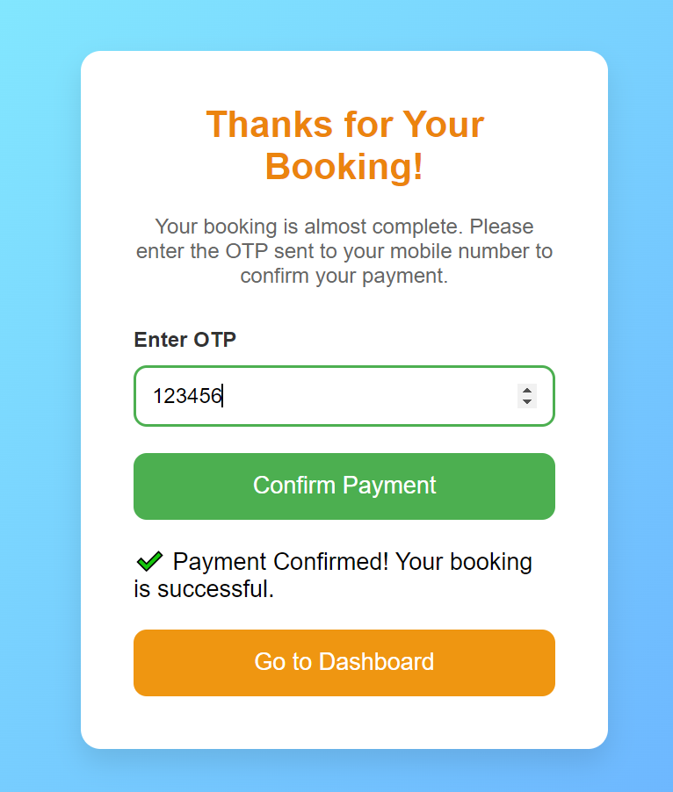

Slide 17
Conclusion
The Epic Journey tours and travels website is designed to provide a seamless and user-friendly experience for travelers looking to explore new destinations and book their journeys with ease. With a clean and intuitive interface, the platform allows users to access comprehensive travel Information,Personalized recommendations, and streamlined booking options. By integrating advanced tools secure payment gateways, Epic Journey ensures that users can manage their travel plans efficiently from any device.

